Slide 1
CHAPTER 11 – MUSCULOSKELETAL SYSTEM Muscles
ATAR UNIT 1 & 2 HUMAN BIOLOGY

Slide 2
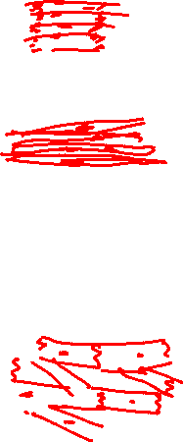
Types of muscles
There are three types of muscle tissues:
Skeletal muscle: attached to the bones of the skeleton. When they contract movement of joints occurs. Under voluntary (conscious) control.
Smooth (involuntary) muscle: this surrounds many internal organs, such as the stomach and intestines, and forms part of the lining of arteries and arterioles. When the intestinal muscles contract the contents of the alimentary canal are pushed along. They are under involuntary (not conscious) control.
Cardiac muscle: this is the muscle of the heart. When it contracts it reduces the volume of the chambers of the heart and pushes blood out of the heart. This is also under involuntary (not conscious) control.

Slide 3
Muscle has the properties of:
Contraction (or shortening): When muscles contract they reduce the distance between the parts they are connected to, or they decrease the volume of the space they surround.
Extensibility (stretch): The muscle can be stretched past their resting length when relaxed.
Elasticity: This means that the muscle can return to the original length after being stretched.

Slide 4
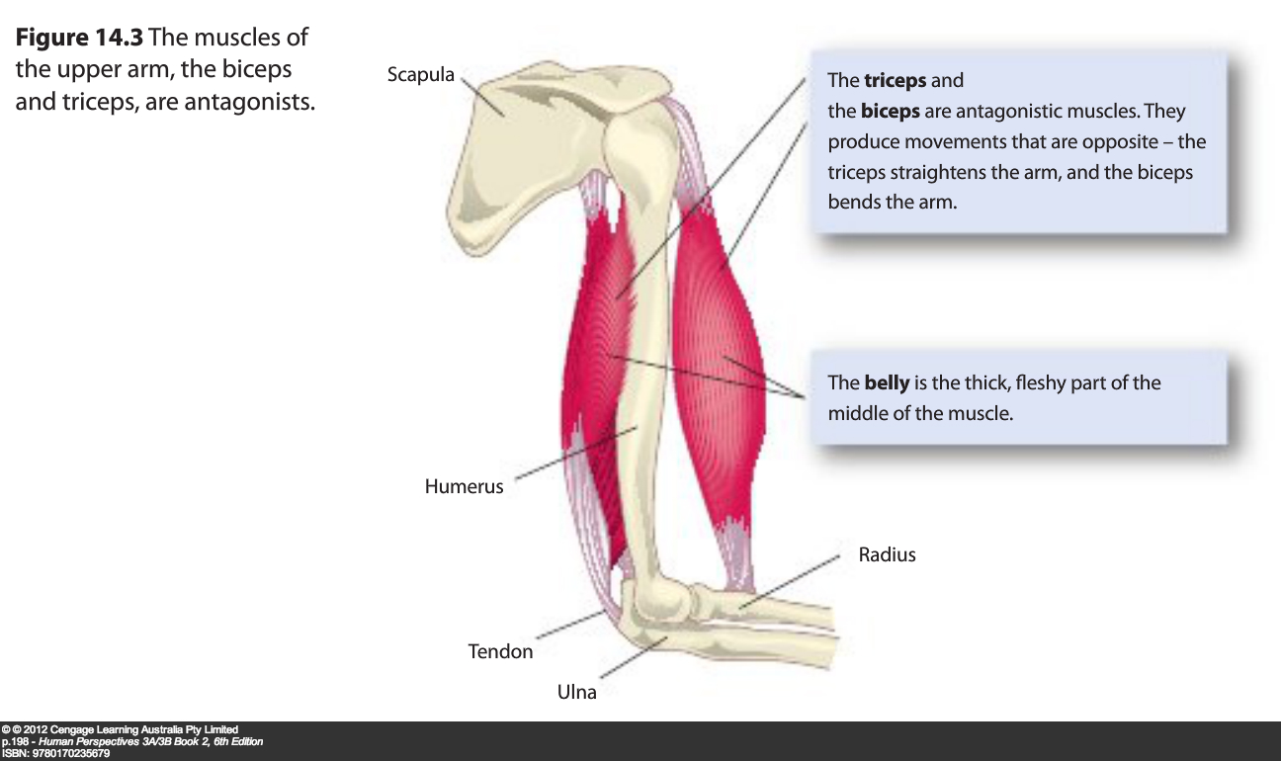
Macroscopic structure of muscle

Slide 5
Muscles are connected to the bones by fibrous, inelastic connective tissue called tendons.
The end of a muscle fixed to a stationary bone is called the origin.
The end of the muscle fixed to the movable bone is called the insertion.
The fleshy part in the middle of the muscle is called the belly.
For example the scapula doesn’t move when the elbow is flexed. The origin of the biceps is here. The radius does move when the elbow is flexed. The insertion of the biceps is here.

Slide 6
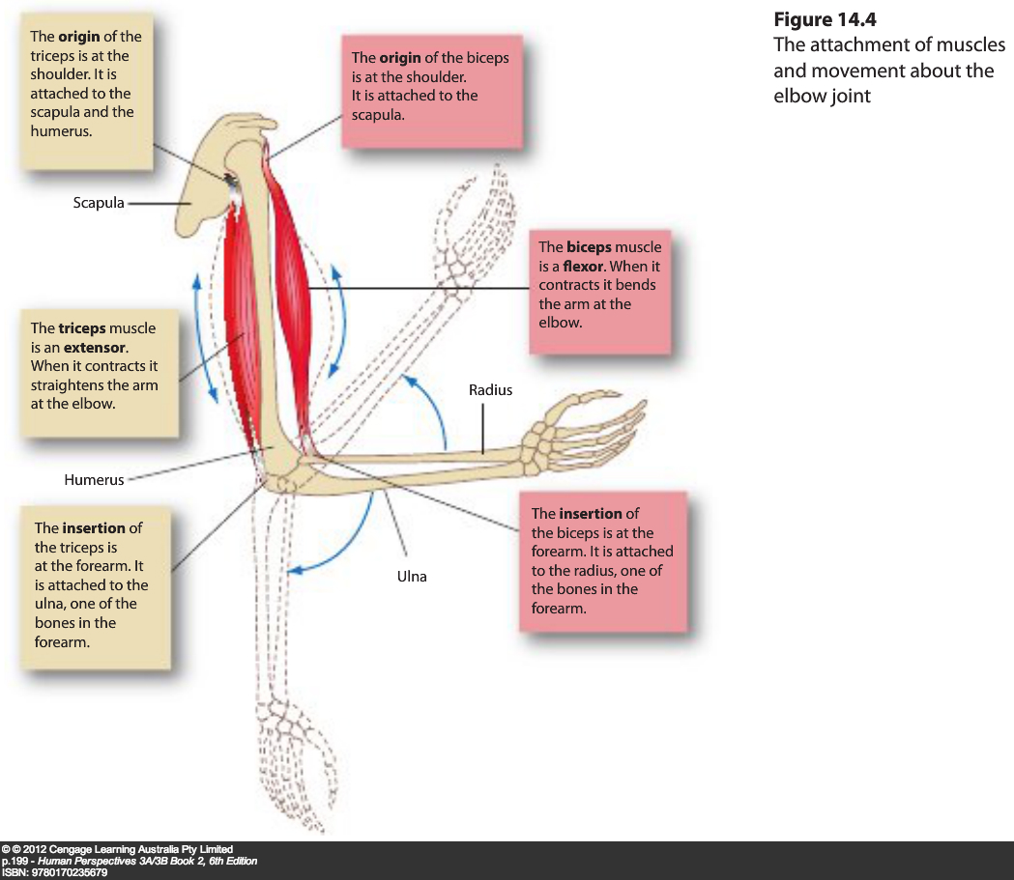

Slide 7
Antagonistic muscles
Since muscles can only contract they can pull bones together, but they cannot push them apart.
This means that if muscles contract to pull a bone in one direction there must be another muscle to pull the bone in the opposite direction.
Skeletal muscles are grouped in pairs, so that this can occur.

Slide 8
The biceps is attached to the scapula at one end, and the radius at the other end. It can be seen at the front of the upper arm.
The triceps is attached to the scapula and humerus at one end, and the ulna at the other. It can be seen at the back of the upper arm.
These two muscles work as an antagonistic pair to flex and extend the elbow.
When the biceps contracts the triceps relaxes and the elbow bends.
When the triceps contracts the bicep relaxes, and the elbow straightens.
The muscle that causes the action is called the agonist, or prime mover. The muscle that yields to this action is called the antagonist.

Slide 9
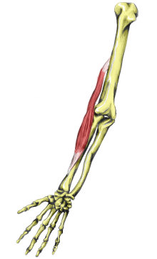
As well as agonists and antagonists joints require a synergist and/or fixator.
Synergists are muscles that help steady a joint during a particular movement.
For example when bending or straightening the
arm the brachioradialis helps to steady the
movement.
Fixators are muscles that immobilise a joint during a particular movement.
For example when you clench your fists your wrist would flex, if it were not for fixators which kept the wrist immobilised during the clenching.
http://www.teachpe.com/anatomy/muscles/brachioradialis.php

Slide 10
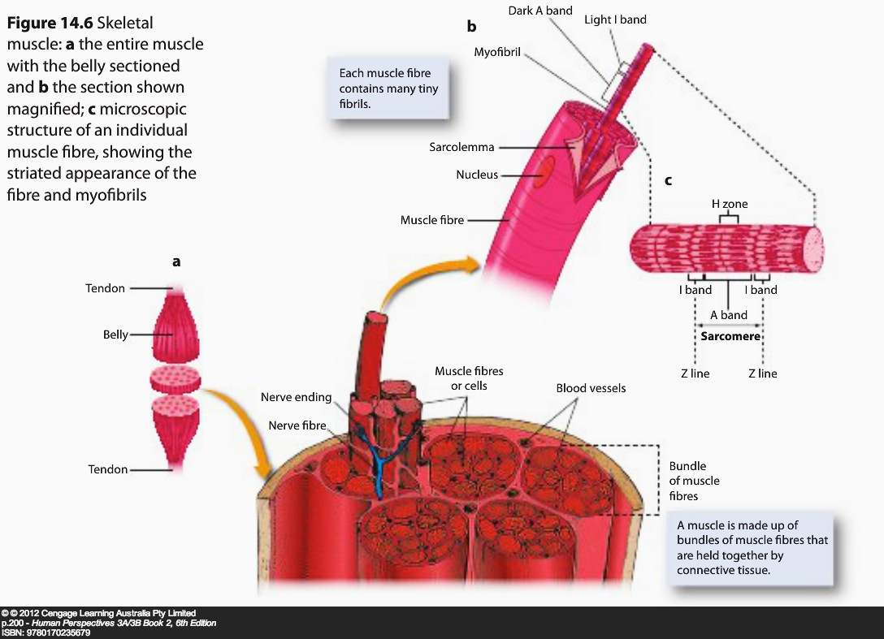
Structure of skeletal muscle

Slide 11
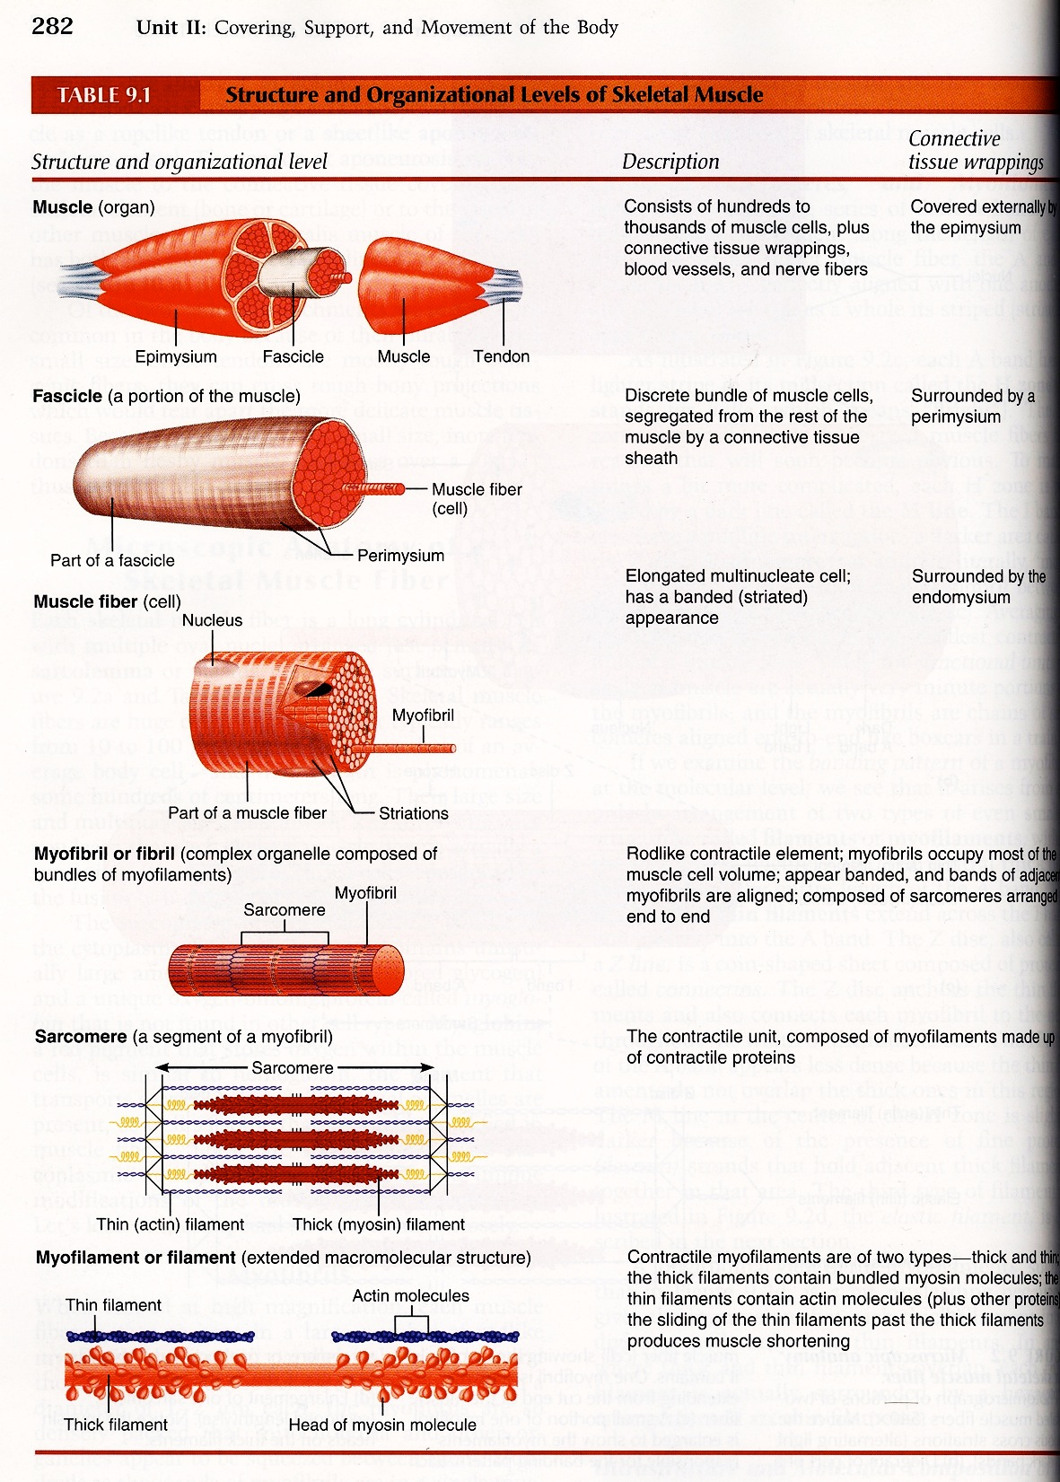
Marieb, 2001, Table 9.1, p. 282

Slide 12
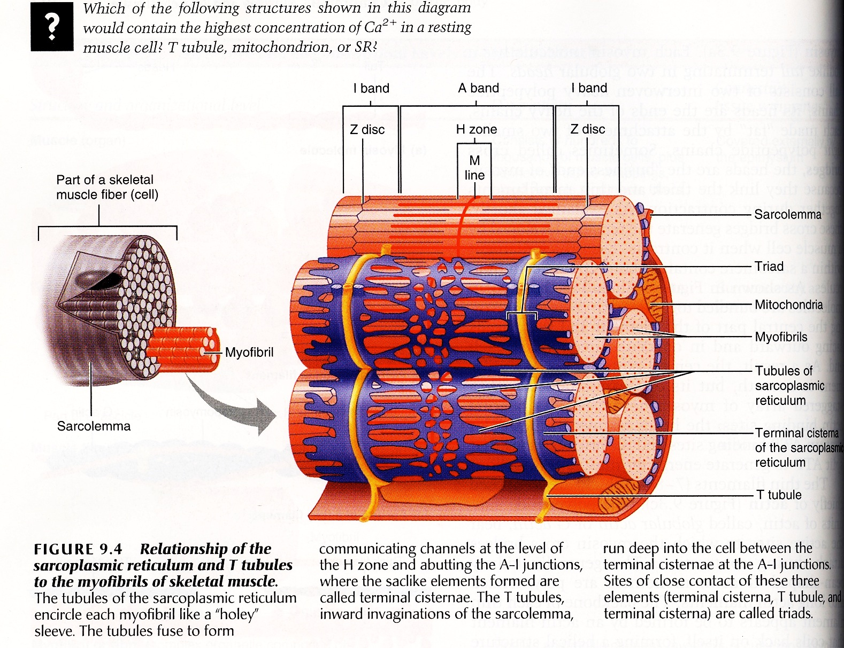
Marieb, 2001, Figure 9.4, p. 284

Slide 13
Muscle cells are held together in bundles by a sheath of connective tissue. At each end of the sheath the connective tissue tapers and blends to form a tendon.
When a muscle bundle is examined under a microscope it would be seen as a group of muscle cells lying parallel to each other.
A muscle cell (muscle fibre) is actually an elongated cylinder with many nuclei. The cell has a thin, transparent plasma membrane called the sarcolemma and a cytoplasm called the sarcoplasm. These cells are between 10μm and 100μm in diameter and between a few millimetres and a few centimetres in length.
Each muscle fibre has many tiny threads called myofibrils. These lay parallel to each other and run the length of the muscle fibre.

Slide 14
Structure of myofibrils (microscopic structure of muscles)
Myofibrils are made up of smaller structures called myofilaments. There are two types of myofilaments:
Myosin which is the thicker myofilament
Actin which is the thinner myofilament.
These myofilaments are actually proteins, which are responsible for the contraction of the muscles. They give the skeletal and cardiac muscles their striated appearance.
Myofibrils are often divided into subunits called sarcomeres. See figure 14.7

Slide 15
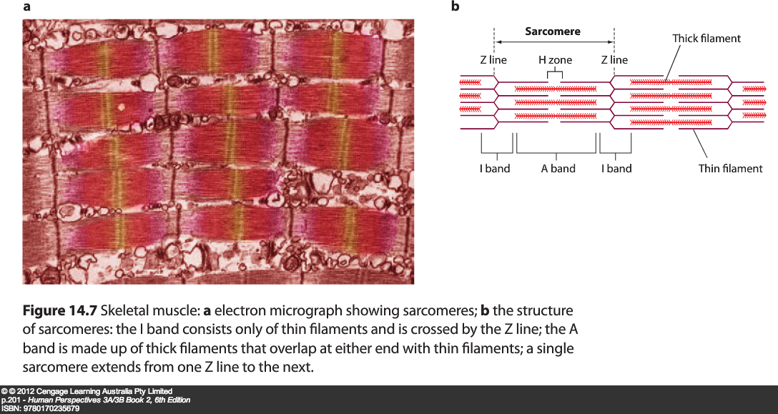
Striated (skeletal) muscle

Slide 16
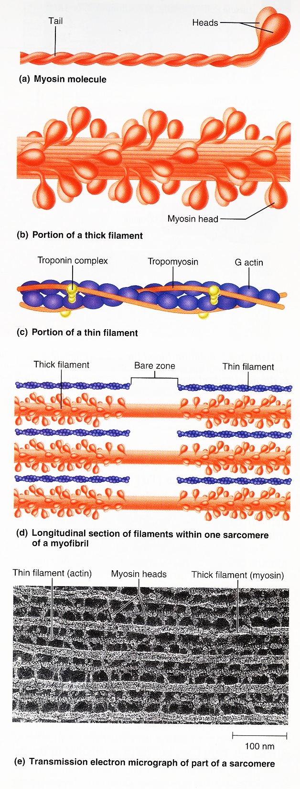
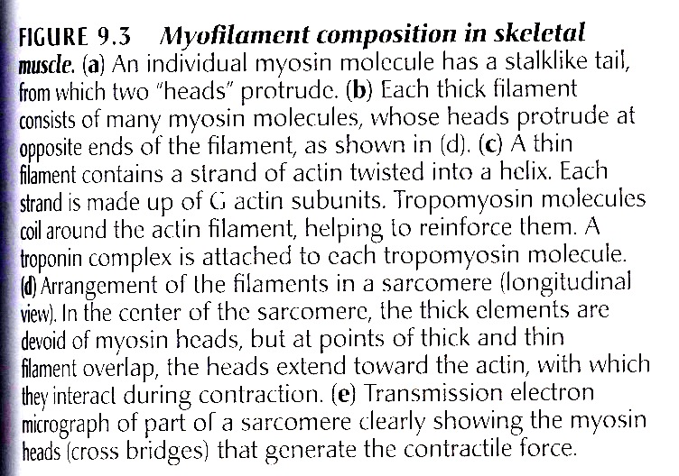
Marieb, 2001, Figure 9.3, p. 283

Slide 17
Sliding filament model
This is an explanation of how the muscles contract. When the muscles contract the sarcomeres shorten because the actin and myosin slide over each other.
The Sarcomeres have some distinct sections:
Z line: This is the section where the part of the actin proteins which looks like lots of Zs stacked on top of each other.
A band: This is the section which contains the myosin proteins.
I band: This is the section that doesn’t contain the myosin proteins.

Slide 18
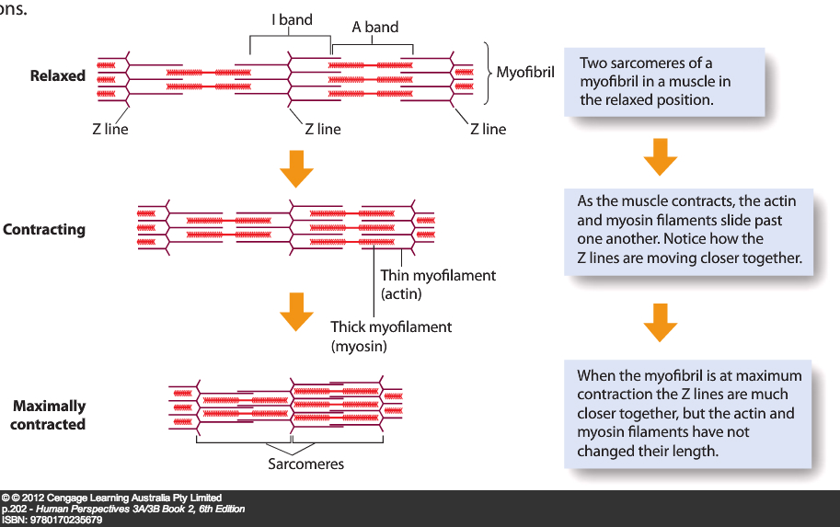
Ca+ released from the sarcoplasmic reticulum causes the formation of cross-bridges between actin and myosin; cross-bridges contract causing actin to slide over myosin.
When the actin and myosin slide over each other the Z lines are drawn closer together and the sarcomere shortens. This results in the shortening of the muscle fibre, and therefore the whole muscle.
When the muscle relaxes the actin and myosin can be pulled past each other in the opposite direction, returning them to their original state.
Energy in the form of ATP is needed for the shortening of the muscle fibres.

